Slide 1

Reaccredited by NAAC with A+ grade]
Batch No: 10
Dept: CSE
20CS298 – Project Work
“Personalized Tutor”
Presented by
Karthikeyan A K - 2101124
Kiran Prabakaran - 2101127
Maheswaran S – 2101140
Supervised by
Dr.Mathiyalagan P
Associate Professor. CSE
Review :Review II
Date :22-03-2025

Slide 2
Contents
S.No | Description | Slide Number
1 | Introduction | 3
2 | Problem identification, scope and objective | 4-5
3 | Literature Survey | 6
4 | Existing technology of the project | 7
5 | Methodology | 8
6 | Results obtained till date | 9-10
7 | Works to be carried out | 11
8 | References | 12

Slide 3
Introduction
The increasing digitization of information has led to the widespread use of diverse document formats such as PDFs, DOCX, and PPTX. As the volume of such data grows, there is a pressing need for intelligent systems capable of efficiently extracting and interpreting content across these Formats.
Traditional keyword-based search techniques are often inadequate as they fail to capture the semantic meaning of queries, resulting in incomplete or inaccurate responses.
This limitation highlights the necessity for advanced question- answering systems that leverage semantic search and contextual understanding.

Slide 4
Problem identification, scope and objectives (Contd.,)
Problem Definition
Students struggle to extract relevant information from lengthy documents like PDFs, DOCX, and PPTX files. Traditional search methods require reading through pages manually, which is time-consuming and inefficient. A smarter solution is needed to quickly retrieve answers from documents using AI.
Scope
Supports PDF, DOCX, and PPTX files.
Uses FAISS (Facebook AI Similarity Search) for efficient text retrieval.
Uses Hugging Face LLMs (Falcon, LLaMA, Mistral) for answering questions.
Converts answers into speech (gTTS) for accessibility.

Slide 5
Problem identification, scope and objectives
Efficient Information Retrieval : Enable users to quickly find relevant information from large documents without manually searching.
AI-Powered Question Answering : Provide accurate, context-aware answers to user queries based on document content.
User-Friendly Accessibility & Interaction : Make the system easy to use with feature like voice output.
Objectives

Slide 6
Literature Survey – 01 (Template)
Source: Shivraj Banjade, Hiran Patel, Sangita Pokhrel (2024) Empowering Education by Developing and Evaluating Generative AI-Powered Tutoring System for Enhanced Student Learning. Journal of Artificial Intelligence and Capsule Networks, 6 (3). pp. 278-298.
Experiment | Inference | Problem gap
Explores the capabilities of advanced language models, including OpenAI and Gemini, in the development of an AI-powered tutoring system. | AI improved learning efficiency and engagement, reducing content creation time while enhancing interactivity. However, human review was needed to ensure accuracy and relevance. | Some of the challenges remain, including limited contextual understanding, lack of customization, ethical and bias concerns, data privacy, and technical accessibility.

Slide 7
Existing technology of the project
Keyword-Based Search Systems : Keyword-based search systems, such as Lucene and Elasticsearch, are widely used for information retrieval. . They excel at finding exact keyword matches and are efficient for structured and well-labeled datasets. Despite their efficiency, keyword-based systems lack the ability to understand semantic meaning.
Open-Domain Question Answering Models : Open-domain QA models, such as BERT-QA, GPT-3, and LLaMA, offer natural language understanding across various topics without being restricted to a predefined dataset. Without retrieval mechanisms like FAISS, these models cannot effectively process or retrieve custom user content for personalized educational support

Slide 8
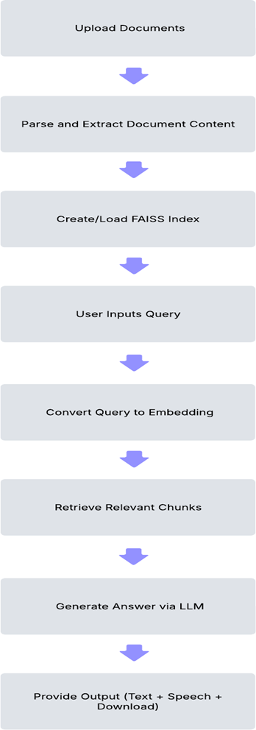
Methodology to be adopted
Flow Chart

Slide 9
Design & Experimentation
Document Processing (PDF Extraction & FAISS Indexing)
Extracts raw text from PDFs using PyMuPDF (fitz).
Splits text into semantic chunks for efficient retrieval.
Converts text chunks into embeddings using Sentence Transformers.
Stores embeddings in a FAISS (Facebook AI Similarity Search) index for efficient search.
Question Answering Pipeline
Uses pre-trained Hugging Face models (Falcon, Pegasus, LLaMA, Mistral) to generate answers.
Uses LangChain’s LLMChain for structured question-answering.
Uses a contextual prompt template to enhance LLM accuracy.

Slide 10
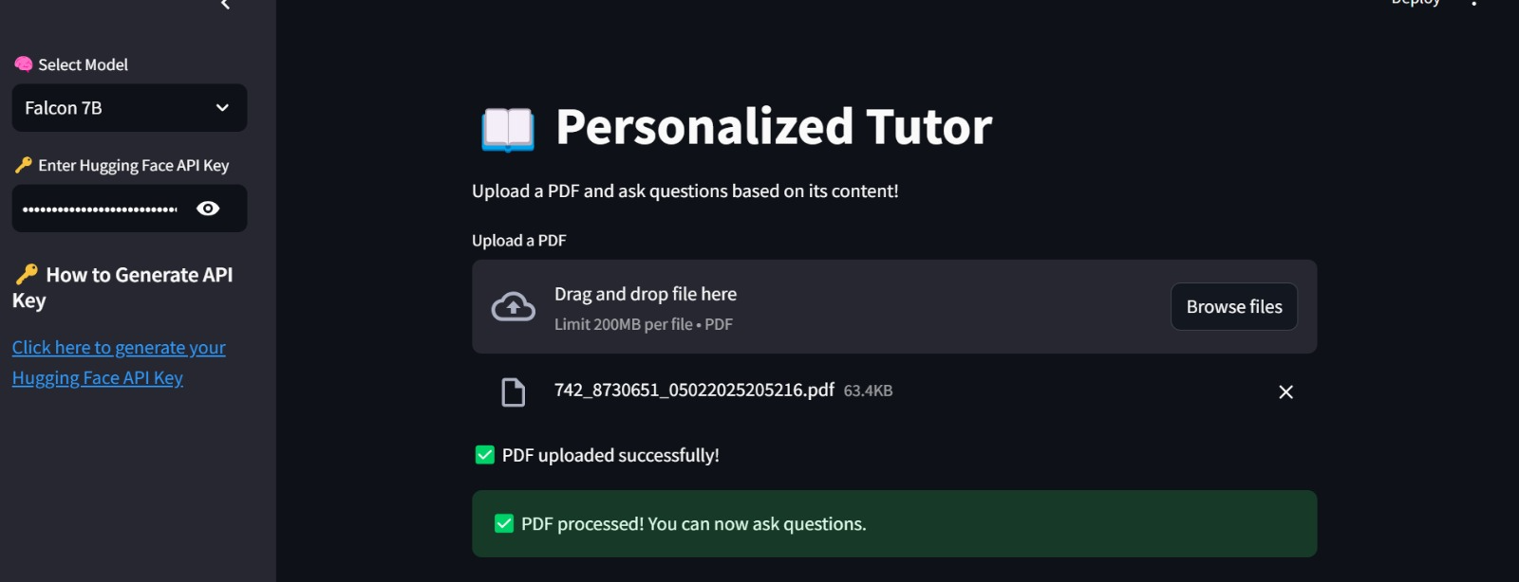
Results obtained till date

Slide 11
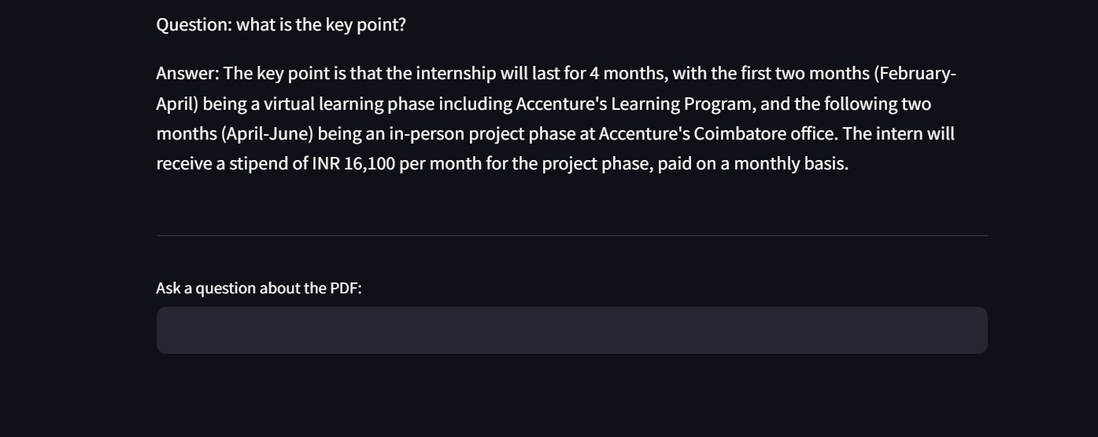
Results obtained till date

Slide 12
Works to be carried out
To incorporate voice based output.
To enable users to upload files in multiple formats.

Slide 13
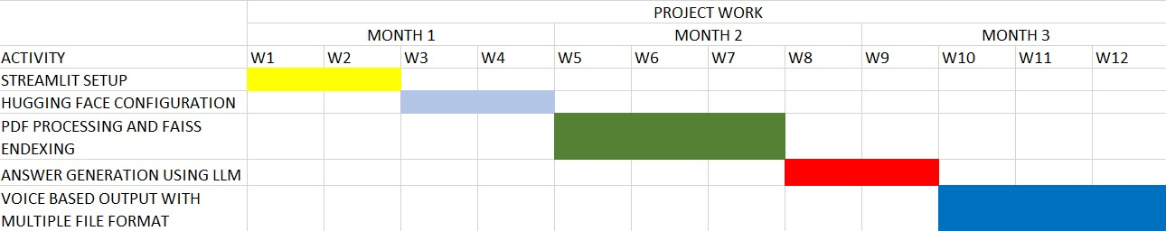
Timeline of the project

Slide 14
Proposed Project Outcome
The personalized tutor system provides an efficient and intelligent solution for processing multi-format documents and delivering accurate, context-aware responses.
By combining advanced text extraction techniques, FAISS-based semantic search, and powerful Large Language Models (LLMs), the system offers fast and reliable answers to user queries.
The system’s ability to generate both text and speech outputs, along with the option to download Q&A sessions in PDF format, enhances its usability and accessibility.

Slide 15
Outcomes (Patent, Paper, Hackatons etc.,) – applied / published / granted
To be published as a Journal paper

Slide 16
References
Banjade, Shivraj, Patel, Hiran and Pokhrel, Sangita ORCID logoORCID: https://orcid.org/0009-0008 2092-7029 (2024) Empowering Education by Developing and Evaluating Generative AI-Powered Tutoring System for Enhanced Student Learning. Journal of Artificial Intelligence and Capsule Networks, 6 (3). pp. 278-298.
Johnson, J., Douze, M., & Jégou, H. (2019). "Billion-scale similarity search with GPUs," IEEE Transactions on Big Data, vol. 7, no. 3, pp. 535–547.
Javed, M., & Gupta, A. (2024). "Document Question Answering Using Large Language Model," International Journal of Advanced Computer Science and Applications (IJACSA), vol. 15, no. 3, pp. 533–540.
Liu, J., Zhou, J., & Xu, X. (2023). "An Adaptive Framework for Retrieval-Augmented Generation in Complex Question Answering for Large Language Models," Applied Sciences, vol. 14, no. 23, pp. 11014.

